Slide 1

G2M insight for Cab Investment firm
Data Glacier intership
17-Oct-2022

Slide 2

Agenda
Executive Summary
Problem Statement
Approach
EDA
EDA Summary
Recommendations

Slide 3
Summary
Background Summary
The XYZ company is planning on investment in the Cab industry.
In order to make final decision in investment, they make a G2M
Strategy to get more information about the market;
This project is based on the market data. By analyzing several indicators of two different Cab companies: Yellow and Pink;
This project will provide technologies advice to support decision making.

Slide 4
Summary
Data Summary:
This Project will apply 4 datasets for analyzing:
Cab_Data.csv: including the record for every single Cab transaction, including City, Distance, Cost and Charge.
Customer_ID.csv: including personal information for every customer.
Transaction_ID.csv: including Transaction number, Customer number and payment mode(cash or card).
City.csv: including the city population and user information for each city.

Slide 5
Data Analysis
The Data Analysis will contain several parts:
Outlier Detect: Examine, correct and delete abnormal data. Such as 0 or extremely large data.
Correlation Detect: Check out whether two data has positive or negative relation or not.
Making Charts: Building charts of the same data from two companies to compare the performance of two companies.

Slide 6
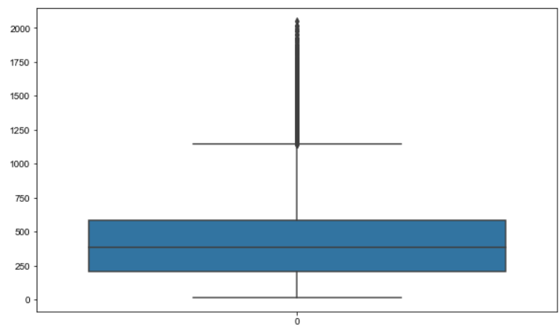
Outlier Detect
The boxplot is the left is the outlier detect of price_charged.
We will accept all the data.
There is no obviously abnormal values.
Some high price charged are reasonable.
They are caused by luxurious car type and distance.

Slide 7
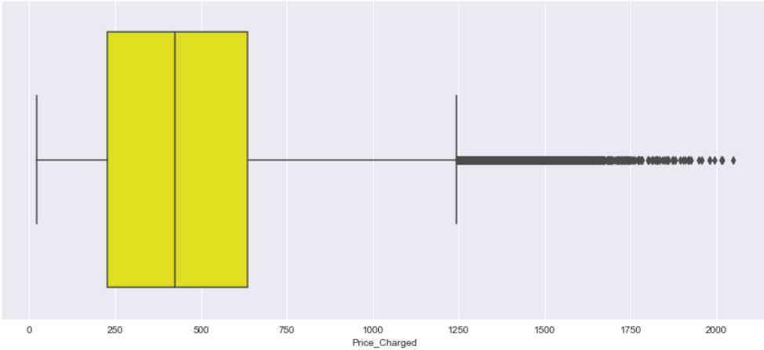
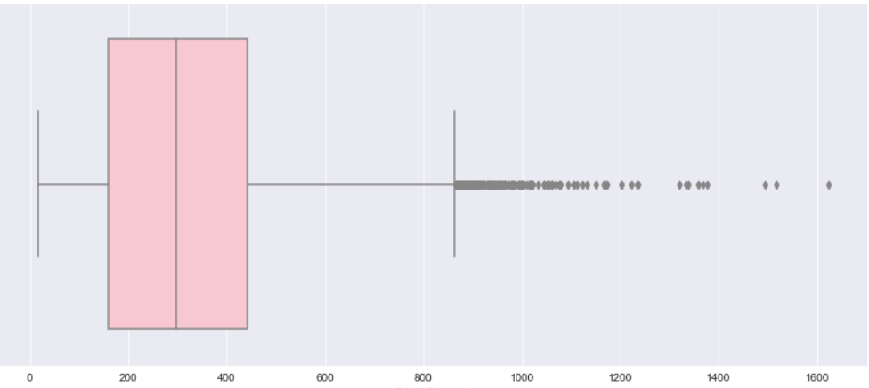
Income Compare The Yellow Cab has price range of 250-2250. While the Pink Cab has price range of 250 – 2000. On the whole, Yellow Cab has BETTER price charge than Pink Cab.

Slide 8
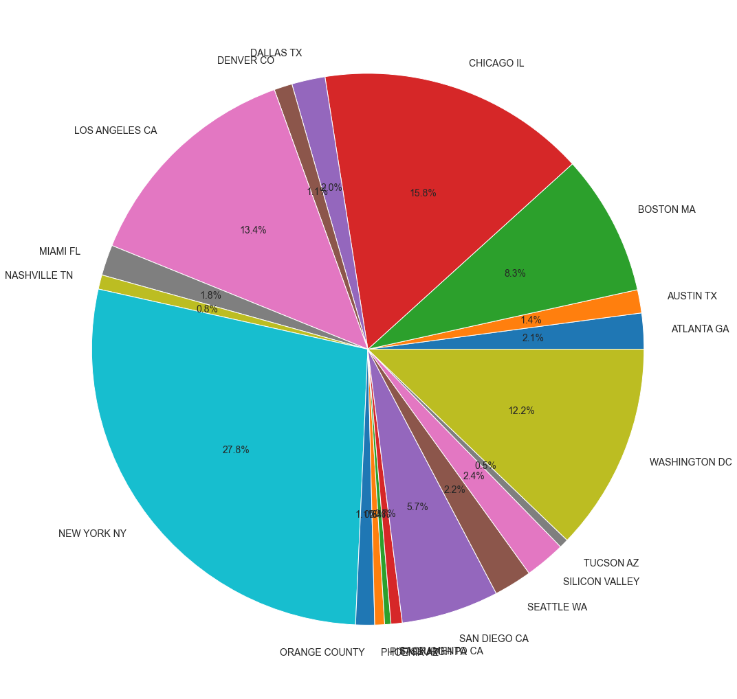
Find Main Market City
From the Chart, we are SURE that four main market are:
CHICAGO
LOS ANGELES
NEW YORK
WASHINGTON

Slide 9
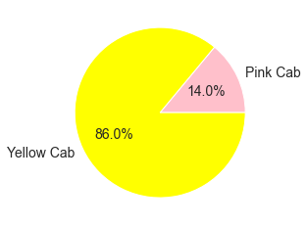
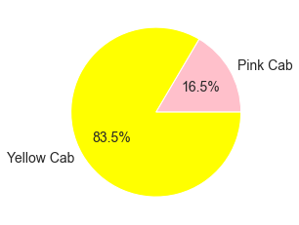
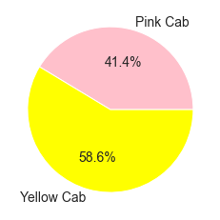
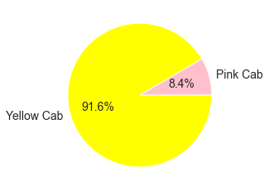
Main Market
The Four charts compare users number in main cities:
New York Wasthington
Los Angles Chicago

Slide 10
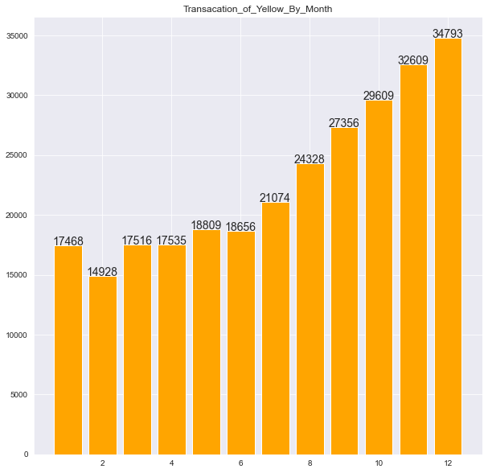
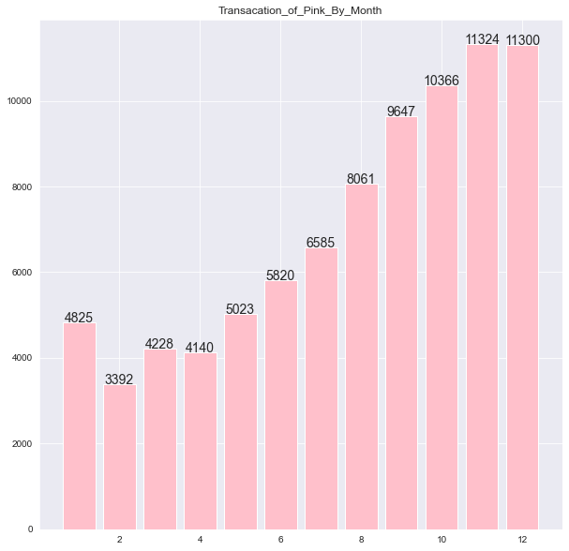
Compare Transactions by Month
Yellow has better monthly Transaction than Pink.

Slide 11
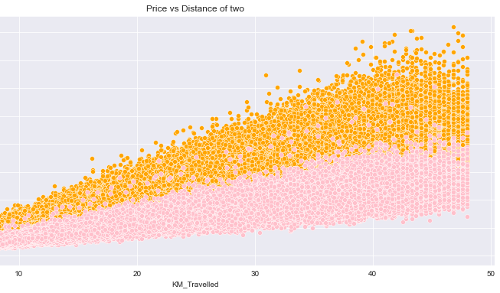
Correlation Detect
The left is the correlation of Price and Distance.
We know that they are positive relation.
Yellow Cab has better coefficient than Pink Cab.

Slide 12
Conclusion
Based on the Analysis, we would make the conclusion:
Yellow Cab is a more valuable investment:
Yellow Cab has better income range;
Yellow Cab has better User Market in main cities;
Yellow Cab has better monthly Transaction;
Based on the same correlation, with the same travel distance, Yellow Cab has better income.

Slide 13
Thank You

